Slide 1
PYSANKY: Ukrainian Easter Eggs
BY: Diane Sudduth of Arch Reactor

Slide 2
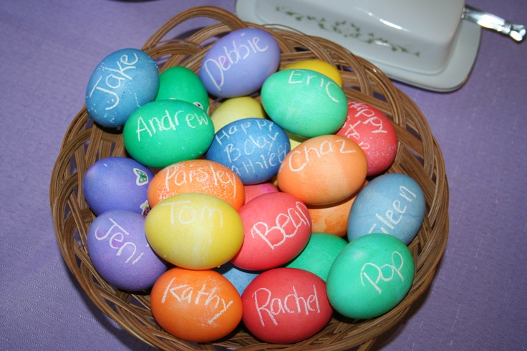
Have you ever used a white or wax crayon to write your name on an egg and then dipped the egg in dye?

Slide 3
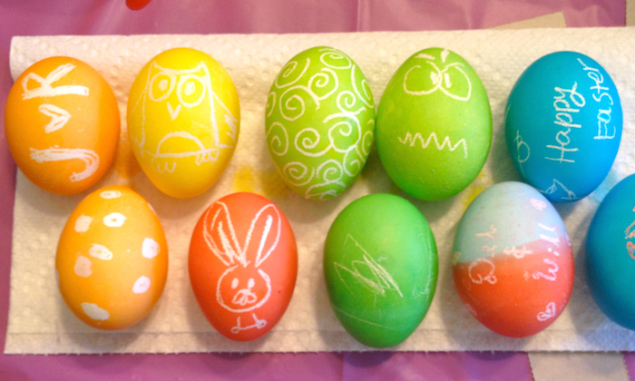
Some people draw pictures and patterns with white crayon before dyeing their eggs

Slide 4
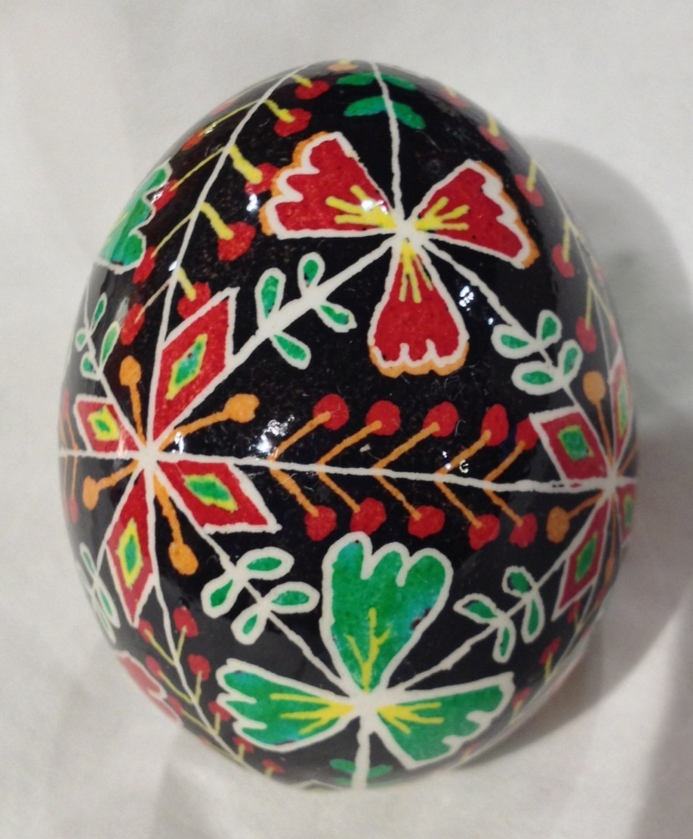
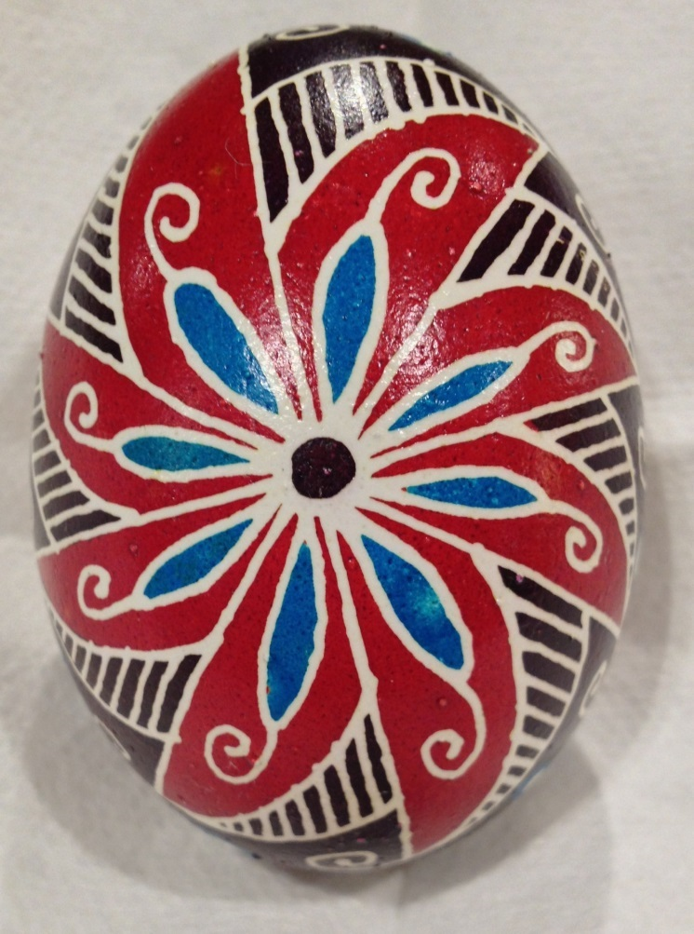
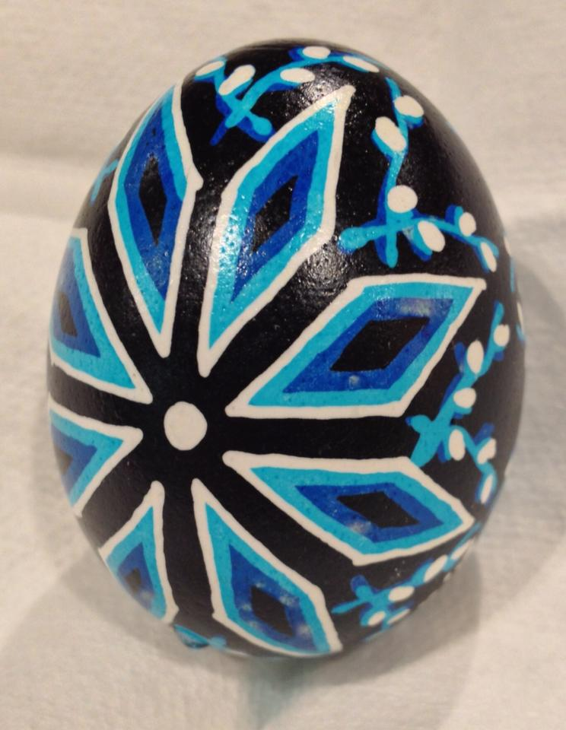
The Ukrainian people use fine tools to “write” onto eggs with wax and use beautiful dyes to make gorgeous eggs.

Slide 5
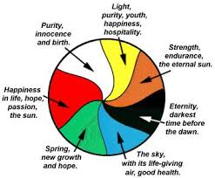
History and Symbolism
The Ukrainian people have been decorating eggs for several thousand years. The colors and patterns chosen have taken on special meanings over time. Traditional designs have “meanings” and by considering pattern and color it’s possible to design an egg with very specific meanings.
Colors:

Slide 7
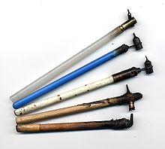
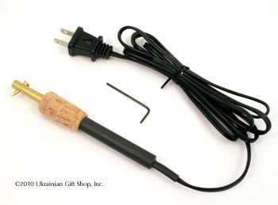
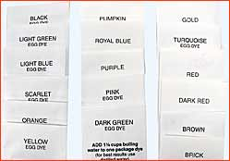
Materials Needed:
Raw Eggs at Room Temperature
A pencil (but not the eraser!!)
Pure Beeswax
A stylus – or kistka
A selection of dyes (pre-packaged to make 1 pint of dye)
Heated By Candle Flame Or Electric

Slide 8
REMEMBER!
You are going to work with raw eggs and will not drain the egg until completely finished.
The dyes you will use are not safe to eat, so please do not eat the eggs. This is art, not food.
Start with eggs at room temperature and leave them out! If you chill the egg once you’ve begun decorating it will harden the wax which can flake off, and condensation on a cold eggshell will cause the water-soluble dyes to run. Contrary to popular belief, eggs will not spoil for at least a week or two.

Slide 9
Process:
Start by sketching a design on your raw egg with pencil (do not use the eraser, it can scratch the shell) Start with major divisions, using whichever is most appropriate for your final design

Slide 10
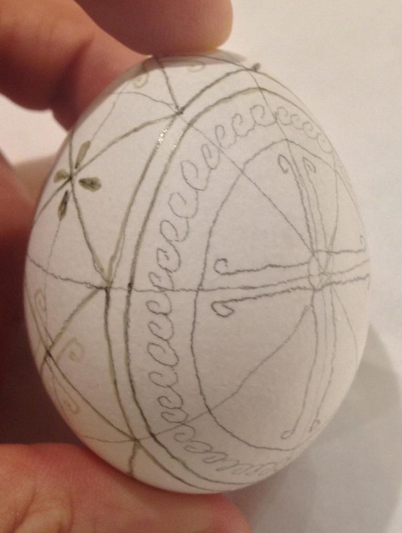
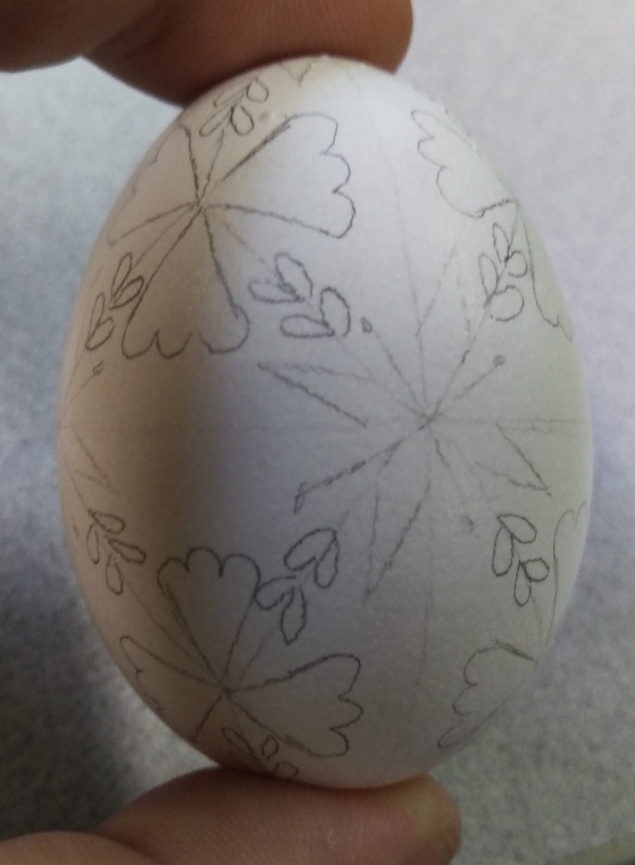
Process (cont.):
Sketch in the Details

Slide 11
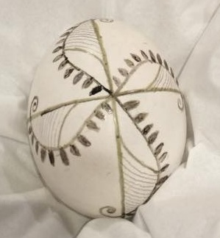
Process (cont.):
Using your kistky, write beeswax onto the egg everywhere you want the egg to remain white. REMEMBER! Once applied, wax cannot be completely removed. Imagine that the kistky and beeswax is a permanent sharpie marker.

Slide 12
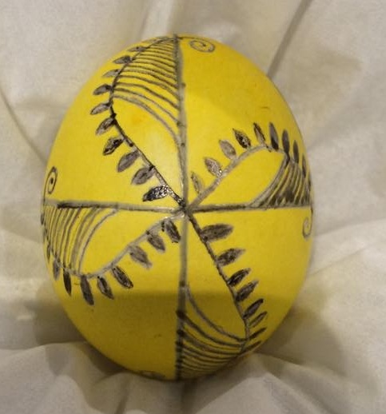
Process (cont.):
Submerge your waxed egg into yellow dye. Stir gently every few minutes until you like the depth of yellow achieved.
Gently remove the egg from the dye and BLOT dry. DO Not Rub! Let egg dry completely before the next step.
Using your kistky and beeswax, apply wax everywhere you’d like the egg to remain Yellow.

Slide 13
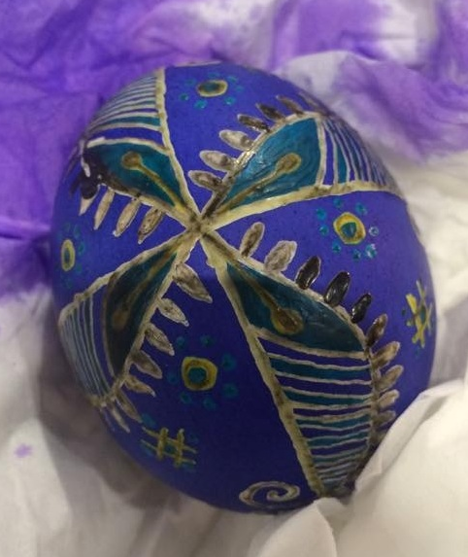
Process (cont.):
Continue dye, blot dry, wax process with any additional colors, working from light colors to dark colors.

Slide 14
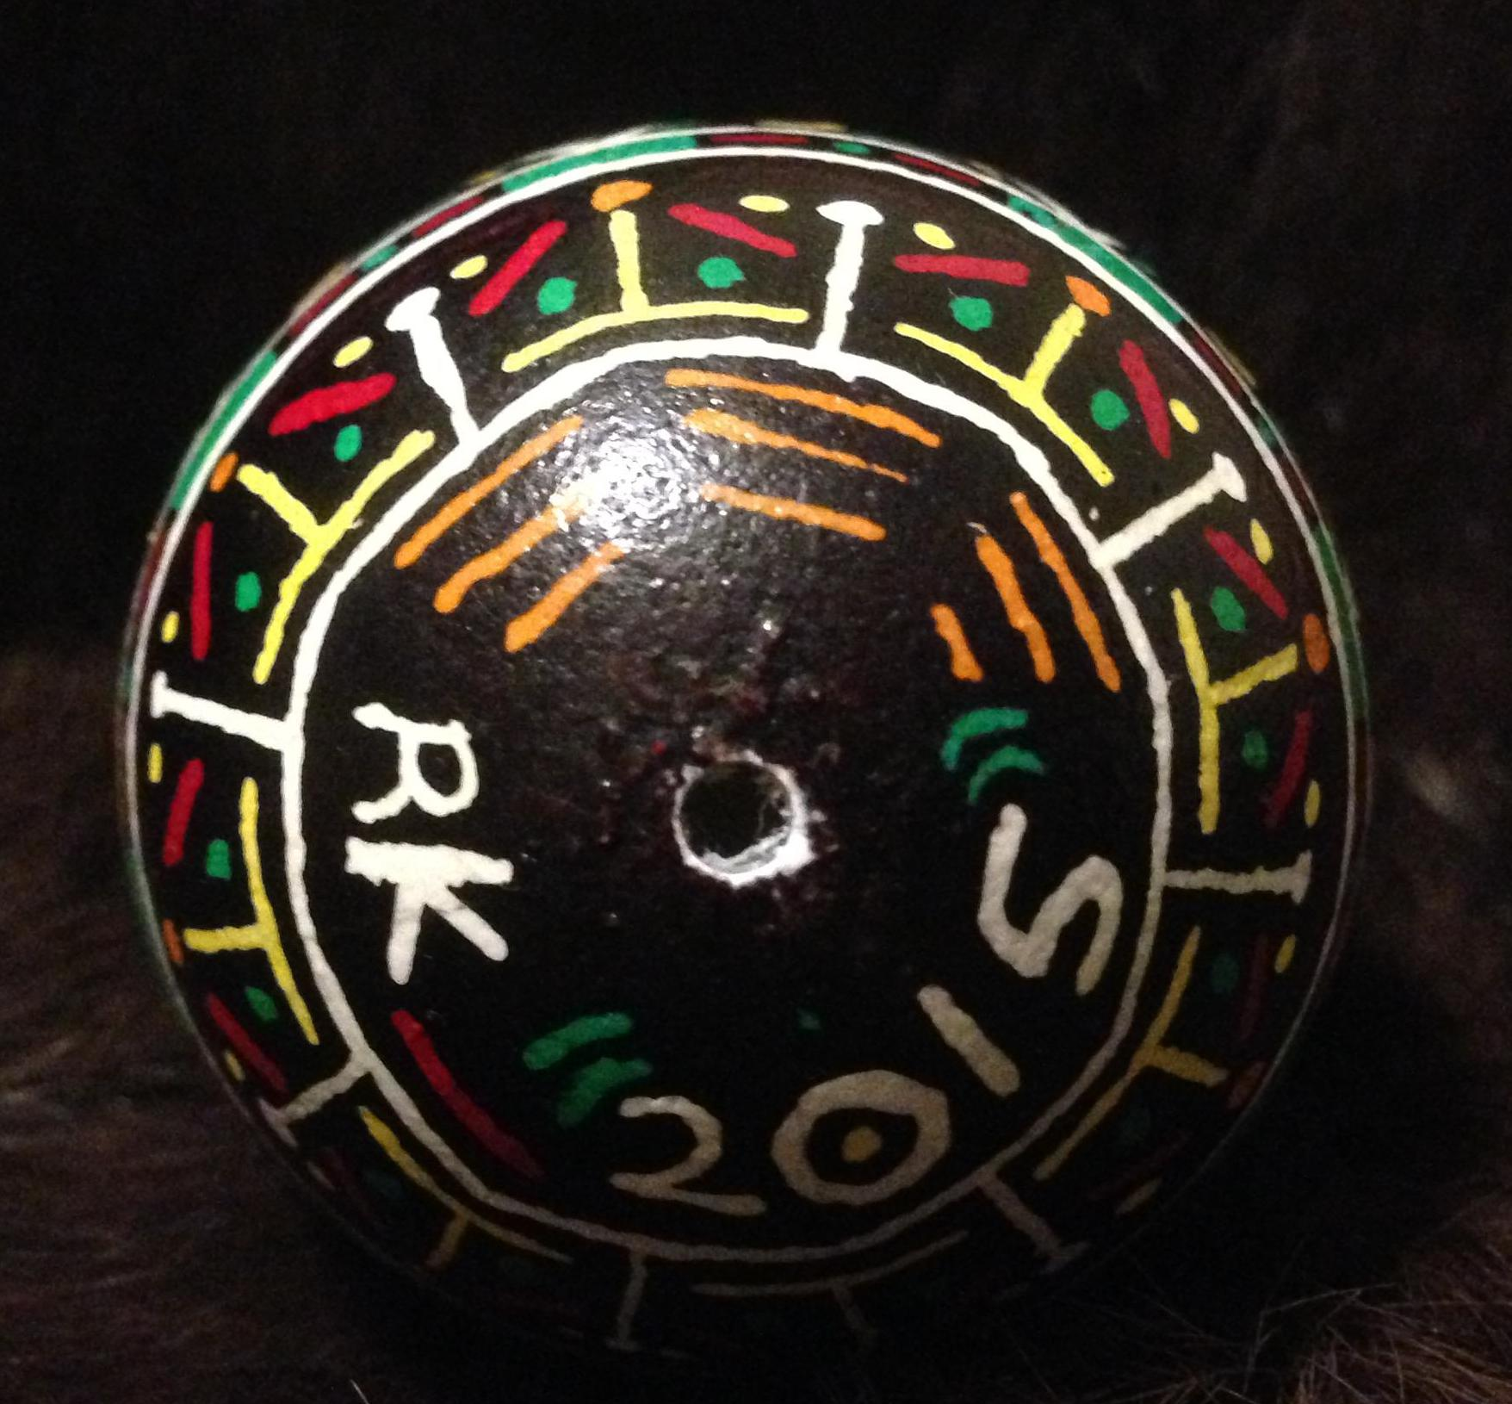
Remember:
Don’t forget to initial and date your work!

Slide 15
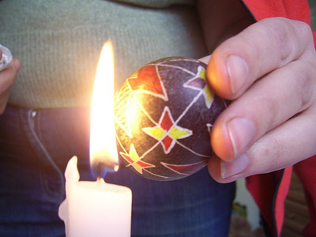
Process (cont.):
To remove the wax, carefully hold the egg to the side of a candle’s flame. Let the heat melt a small section of wax, then quickly wipe with a soft tissue. Continue heating and wiping small sections until all of the wax is removed.
The last residue of wax can be removed by wiping the egg with a small amount of lighter fluid on a soft tissue.
Warning! Extinguish candle flames when working with lighter fluid!

Slide 16
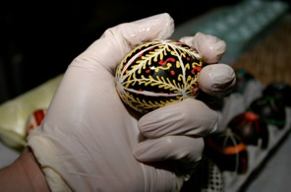
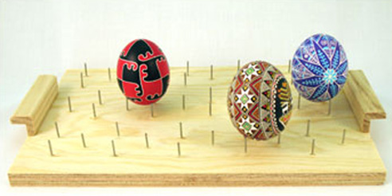
Process (cont.):
The dyes are water-soluble, so you need to seal the eggshell before drilling a small hole and draining the egg. Use an oil-based varnish or polyurethane, but apply some to a “test egg” first to ensure that the sealant will not make the dyes run and ruin your pattern.
One method is to put a drop or two of varnish in your gloved hand then roll the egg around to completely cover.
Do not use too much varnish or it may streak and drip. Set to try thoroughly on a pin-board (commercially available, or you can make your own)
It takes longer, but multiple thin coats of varnish are recommended. Let dry thoroughly between each coat.

Slide 17
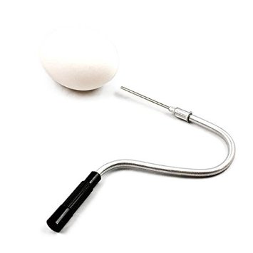
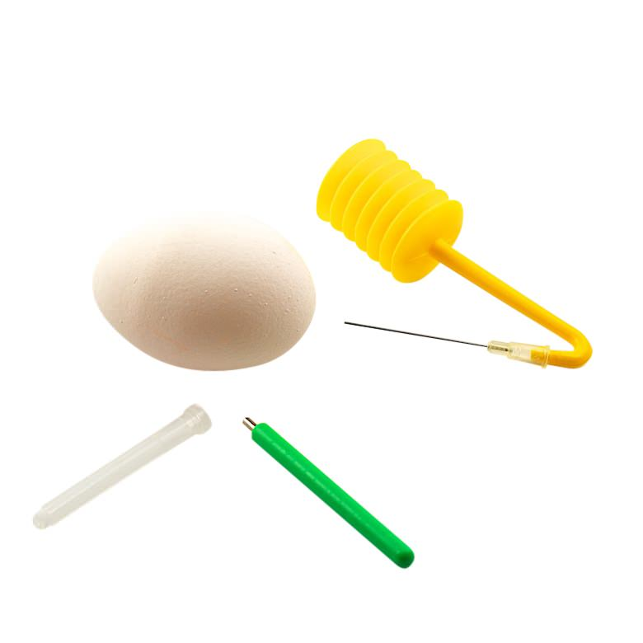
Process (cont.):
Finally, its time to remove the raw egg from inside the shell. The dyes are not safe to eat, so please do not attempt to eat the egg! Drill a small hole in one end of the egg. You can use a small drill-bit, a Dremel bit, or you can carefully poke multiple holes close together with a sharp pin. You only need one hole if you can inject air into the shell to force the egg out of the single opening.
You can also use a turkey baster with a needle-tip to carefully blow air into the shell.
If you have none of these tools, add a second hole on the opposite side of the shell and blow manually.

Slide 18
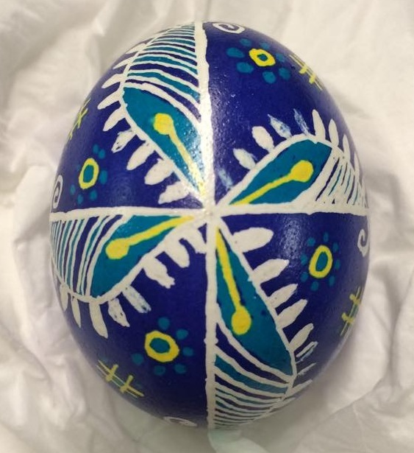
The Finished Product

Slide 19
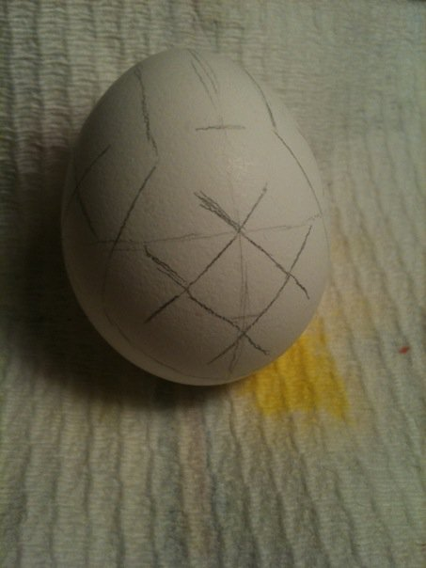
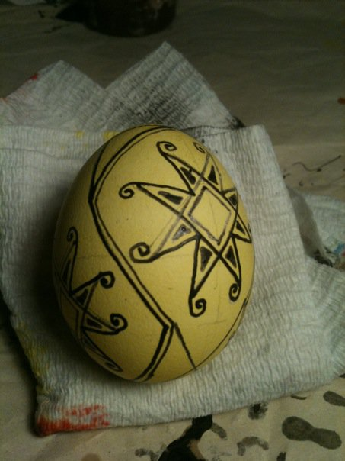
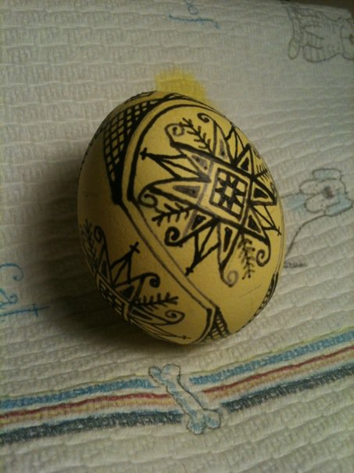
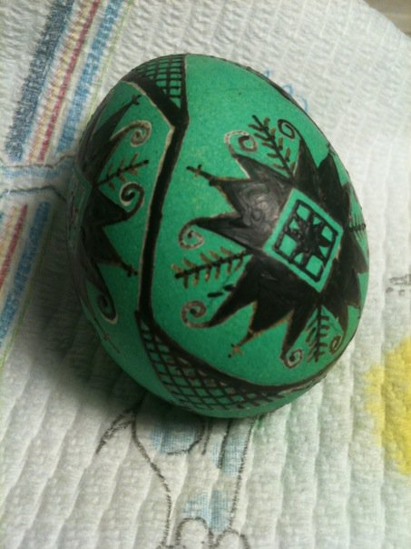
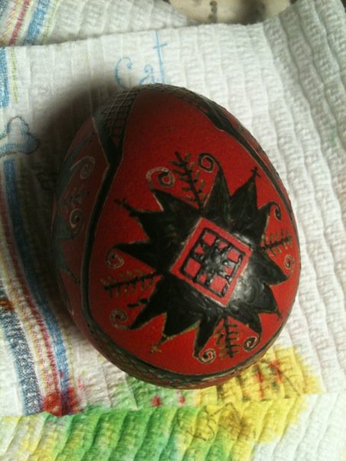
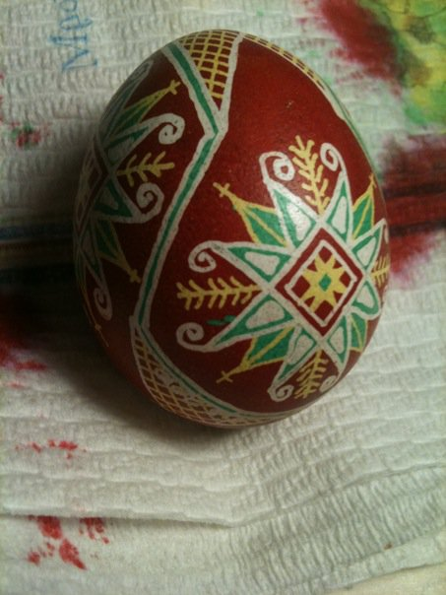
The Full Process

Slide 20
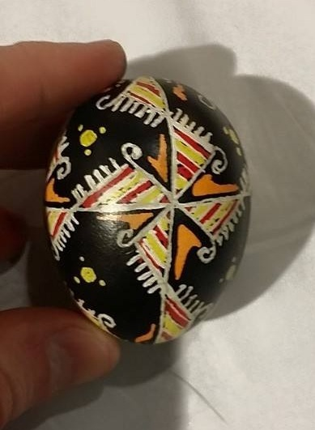
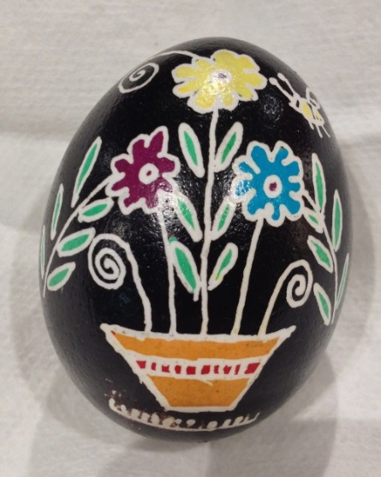
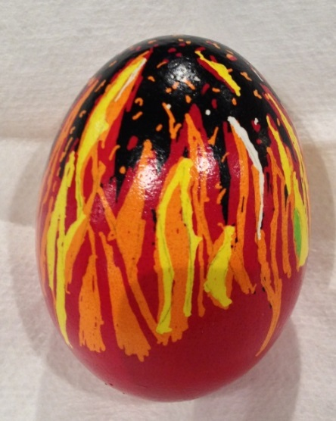
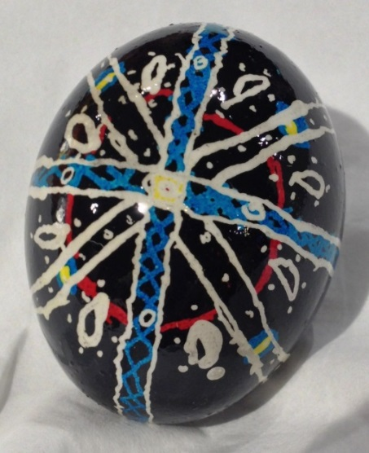
Even Beginners Can Make Beautiful Eggs

Slide 21
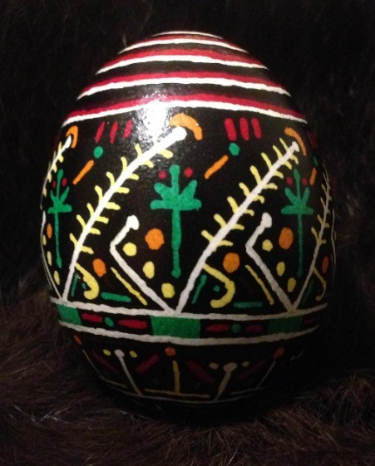
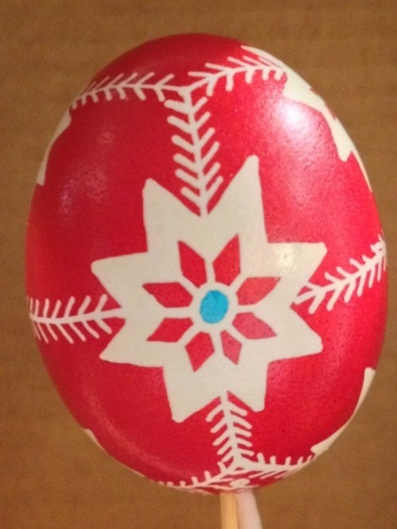
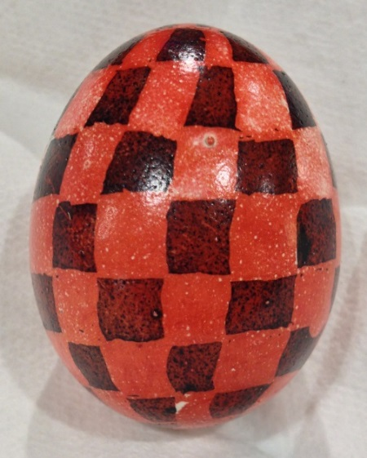
Even Beginners Can Make Beautiful Eggs

Slide 22
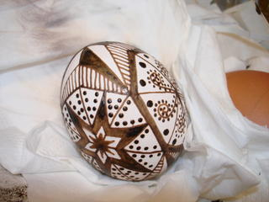
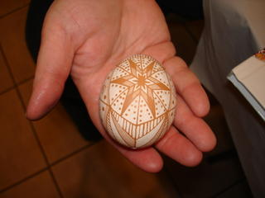
It’s also fun to start with a brown egg, draw a pattern in wax, then dip into a mild acid bath.
Covered in wax after an acid bath:
The reveal:

Slide 23
References:
https://en.wikipedia.org/wiki/Pysanka - Background and Info
http://www.ukrainiangiftshop.com/ - Ukrainian Gift Shop – My source for supplies
http://www.archangelsbooks.com/ - Archangels Books – St. Louis shop with egg supplies
http://www.archreactor.org - Arch Reactor – St Louis Maker Space

